Slide 1
MIS3690 Web Technologies
Babson College
TOIM Division
Fall 2015

Slide 2
Cascading Style Sheets (CSS)
An Introduction

Slide 3
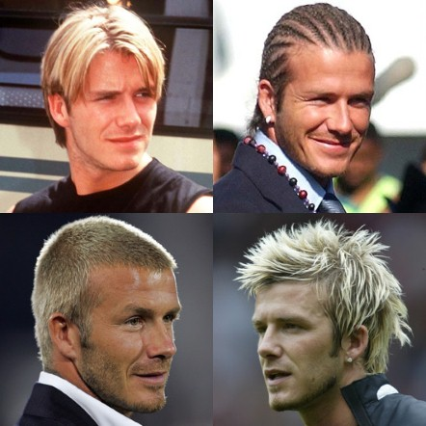
Why Styles?
Styles define how to display HTML elements
Easily change look of a page
Provide consistency in look among pages on a site
Do more than you can with HTML tags
Picture: GETTY/ PA/ REUTERS

Slide 4
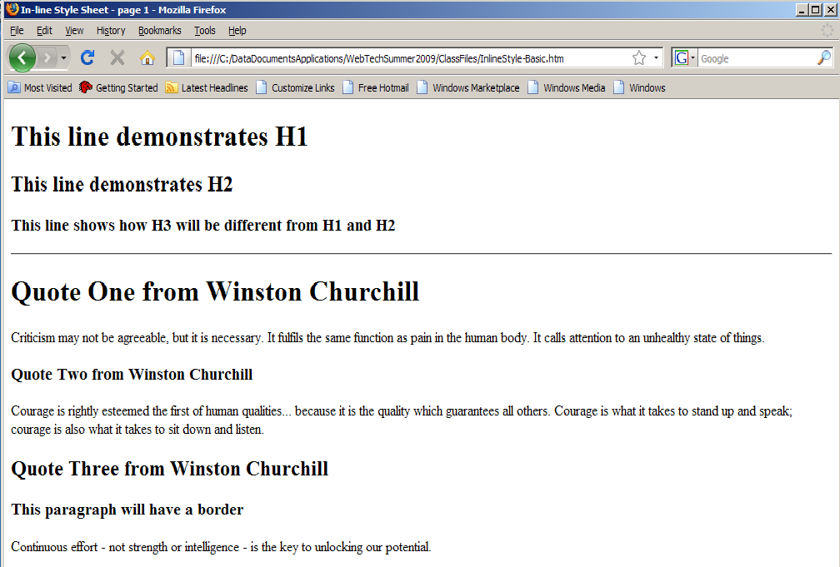
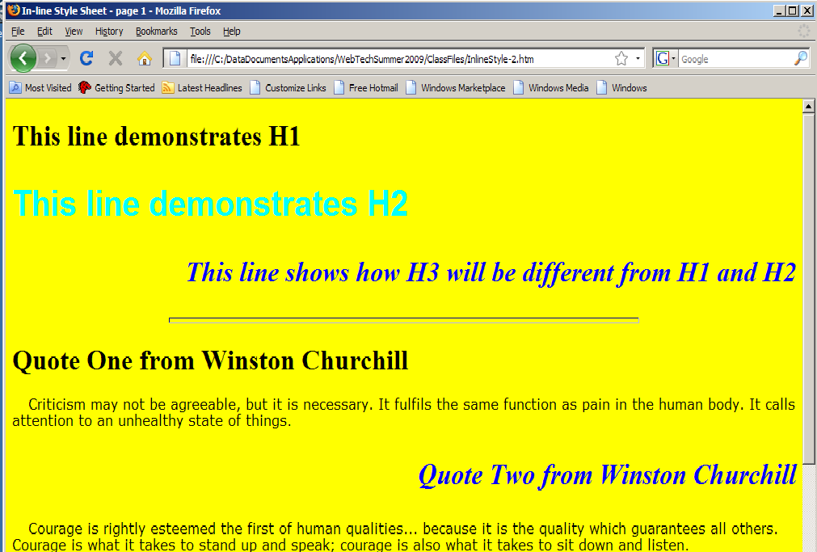
Same Page, Different Styles

Slide 5
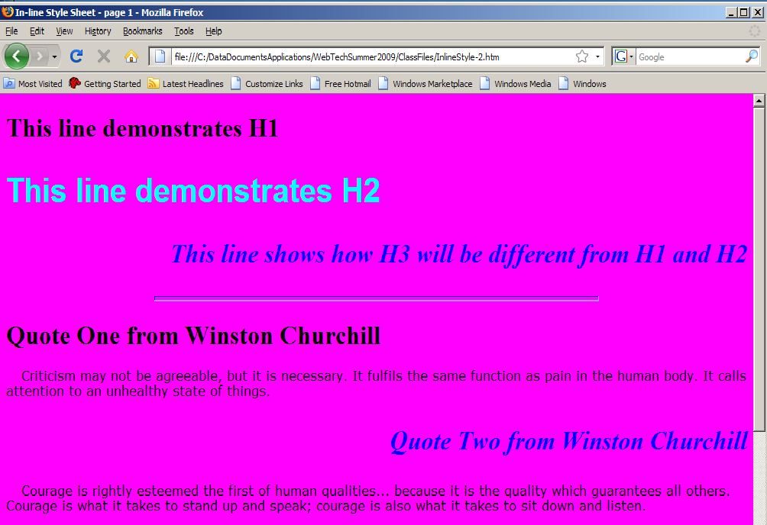
Same Page, Different Styles

Slide 6
Three ways to use CSS
CSS
External Styles
Place stylizing commands in a separate document – you can use the same document to stylize multiple pages.
Internal Styles
Place stylizing commands in the same HTML document that defines your web page.
We will use this in class to learn CSS
In-Line Styles
Place stylizing commands within the specific HTML tag in the document. Will apply only to that specific line/tag.
webpage4
webpage1
webpage2
webpage3
CSS
HTML
One web page CSS in <head> affects HTML in <body>
HTML with CSS embedded within tag definitions
The CSS affects ONLY THAT tag and the contents defined within that page.

Slide 7

Why call it Cascading styles?
You can use all three to stylize a document.
When there is a conflict…
Internal will over-ride external style definition
In-line will over-ride both internal and external definitions
What is a conflict?
When the same tag is styled by more than one definition
For example:
<h1> is defined to have a red font color in external
And… a blue font color in internal
In the document it will be…..?

Slide 8
Creating an Internal Stylesheet
Put styling rules in the <head> section
Surround rules by <style> </style> tags
Example:
<style type="text/css">
Rules go here
</style>

Slide 9

Example
<head>
…
<style type="text/css">
body{background-color:yellow;}
h1{text-align:center; font-family:lucida console; font-size:36pt; color:red}
h2{font-family:arial; font-size:24pt; color:blue}
p{font-family:verdana; font-size:12pt; text-indent:20px;}
hr{width: 60%; color:fuchsia; height:6px;}
</style>
</head>

Slide 10
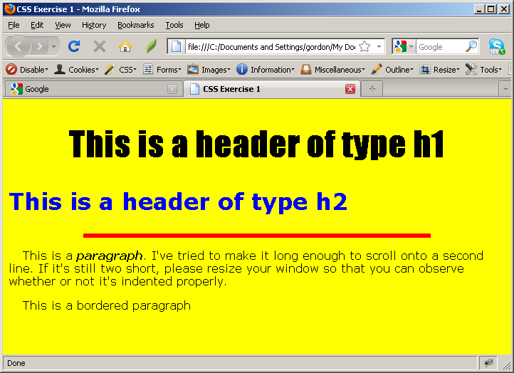
Style Example
<!DOCTYPE html>
<html>
<head>
<title>CSS Exercise 1</title>
<meta http-equiv="content-type" content="text/html; charset=utf-8" />
<style type="text/css">
body {background-color:yellow;}
h1 {text-align:center; font-family:impact; font-size:36pt}
h2 {font-family:verdana; font-size:24pt; color:blue;}
p {font-family:verdana; font-size:12pt; text-indent:20px;}
hr {width:70%; color:red; height: 6px; background-color:red; border:red}
span {font-weight:800; font-style:italic}
</style>
</head>
<body>
<h1>This is a header of type h1</h1>
<h2>This is a header of type h2</h2>
<hr />
<p>This is a <span>paragraph</span>. I've tried to make it long enough to scroll onto a second line.
If it's still two short, please resize your window so that you can observe whether or not it's
indented properly.</p>
<p>This is a bordered paragraph</p>
</body>
</html>

Slide 11
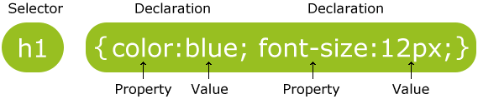
CSS Syntax
Example:
p { color: red; /* This is a single-line comment */ text-align: center; }
/* This is
a multi-line
comment */

Slide 12

Font Styles
font-family: name (e.g., arial)
http://www.w3schools.com/cssref/playit.asp?filename=playcss_font-family
font-style: normal, oblique, italic
http://www.w3schools.com/cssref/playit.asp?filename=playcss_font-style
font-weight: normal, bold, bolder, lighter, or multiple of 100 (400 is normal)
http://www.w3schools.com/cssref/playit.asp?filename=playcss_font-weight
font-size: size*
* Number followed by px, pt, em, or %
Generally, 1em = 12pt = 16px = 100%.
http://www.w3schools.com/cssref/playit.asp?filename=playcss_font-size
font-variant: small-caps, normal, or initial
http://www.w3schools.com/cssref/playit.asp?filename=playcss_font-variant

Slide 13
More Styles for Font
text-transform: capitalize, uppercase, lowercase, none
http://www.w3schools.com/cssref/playit.asp?filename=playcss_text-transform
text-decoration: underline, overline, line-through, or none
http://www.w3schools.com/cssref/playit.asp?filename=playcss_text-decoration
text-align: left, right, center, justify
http://www.w3schools.com/cssref/playit.asp?filename=playcss_text-align
text-indent: size*
* Number followed by px, pt, em, or %
http://www.w3schools.com/cssref/playit.asp?filename=playcss_text-indent

Slide 14
Text Spacing
letter-spacing: normal, or size*
http://www.w3schools.com/cssref/playit.asp?filename=playcss_letter-spacing
word-spacing: normal, or size*
http://www.w3schools.com/cssref/playit.asp?filename=playcss_word-spacing
white-space: pre, nowrap, normal
http://www.w3schools.com/cssref/playit.asp?filename=playcss_white-space
line-height: size*
* Number followed by px, pt, em, or %
http://www.w3schools.com/cssref/playit.asp?filename=playcss_line-height

Slide 15
Text/Image Alignment
For aligning text
text-align: center (or left or right or justify)
For centering an image: (a question that is always asked)
Place the image tag inside <p> </p> tags and then center it like it were text.
<p> <img src="" alt="" title=""> </p>
You can also place the image inside a <div> </div> tag – we will discuss this tag later.

Slide 16
Specifying colors
Using named colors
color:yellow
Using Hexadecimal (or Hex) format
color:#FFFF00
Using RGB format
color:rgb(255,255,0)
For colors by name: http://www.w3schools.com/cssref/css_colornames.asp
For colors by HEX or RGB: http://www.w3schools.com/cssref/css_colors.asp
Let’s play!
http://www.w3schools.com/cssref/playit.asp?filename=playcss_color

Slide 17
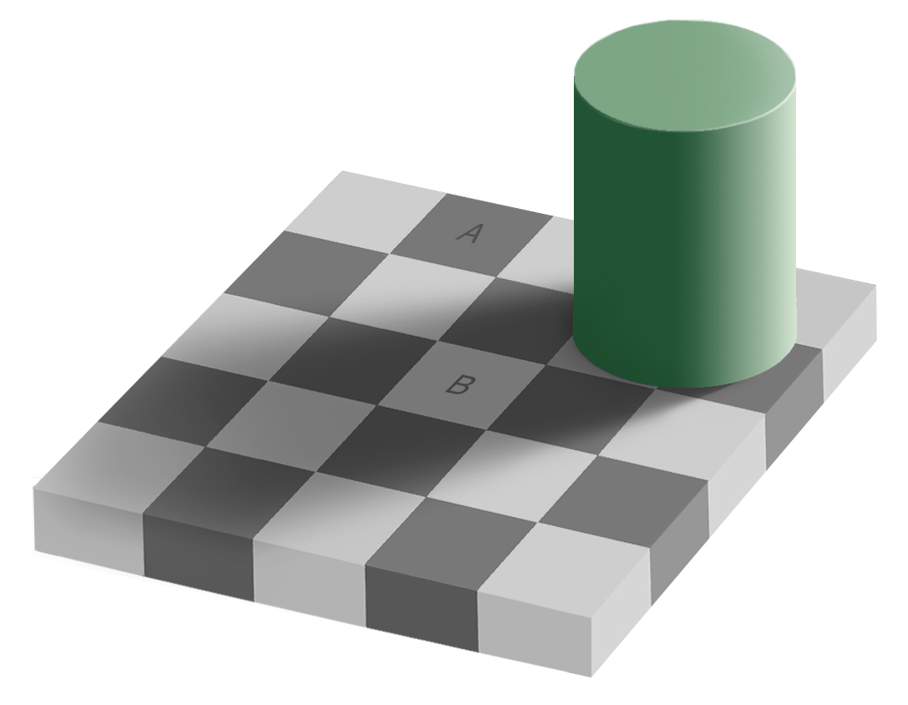
Checker shadow illusion
Square A and B are the same color?

Slide 18
Examples…
Setting the color of text:
h1 {color: blue;}
All text formatted with <h1> and </h1> will be blue.
Setting the background color of a web page:
body {background-color:yellow;}
Sets the background color of the web page to yellow
Setting the font type and font-size:
h3 {font-family:arial; font-size:26pt;}

Slide 19
Style Rule Reference
CSS examples
http://www.w3schools.com/cssref/
Printable Cheat Sheet – for your reference
http://lesliefranke.com/files/reference/csscheatsheet.html

Slide 20
CS03-InClass
Download and save CS03-InClass.htm from BB
Make the following style-changes:
For all h1 tags, set font-family to Lucida Handwriting, color to Navy and center the text on the page.
For all h2 tags, set font to Arial, color to red, set the size of the font to 22pt and left align the text.
For all h3 tags, set font to Calibri, color to olive, size to 1.5em and right align the text.
Set the horizontal rule to 75% width and color it Maroon.
Set paragraphs to Olive color and font to Cursive

Slide 21
Styling Images
Positioning an image
To center an image, enclose the image within <p> and </p> tags and use "text-align:center" for the paragraph!
Typically, images are not centered.
An image may be "floated" left or right.
Floating allows the text to "flow" around the image.
img {float:left;} or img {float:right;}
Adding a border to an image
img {border-width:4px; border-color:red; border-style:solid;}
img {border:4px solid red}
Both above rules do the same thing!!

Slide 22
CS03-InClass (continued)
Download the image of a tiger (from Blackboard, called tiger1.jpg) and save it.
Add the image to the html file, just before the line "In zoos, tigers live for 20 to 26 years…"
Save the file and see how it looks.
In the CSS section add a rule to float the image to the left.
Add a border to the image – 5px thick, solid and red.
Save the file and check to see how it looks.

Slide 23
Margin, border and padding
padding
Element
border
margin

Slide 24
CS03-InClass (continued)
Understanding Padding and Margins using the tiger image.
Please go to www.w3schools.com to find out how to set paddings and margins.
Let us set the padding for the image to 10px on top, right, bottom and left.
Let us set the margin at the top and right to 30px and the margin at the bottom and left to 10px.
See what moves and what does not!!!

Slide 25
FireFTP and Web server
Let us do the setup live.
To test your page, go to the following URL:
http://mis3690-02.babson.edu/<your-id>
You should see your index page.
From here, you should be able to navigate to your LOW page.
From there, you should be able to view each of your deliverables.

